Slide 1
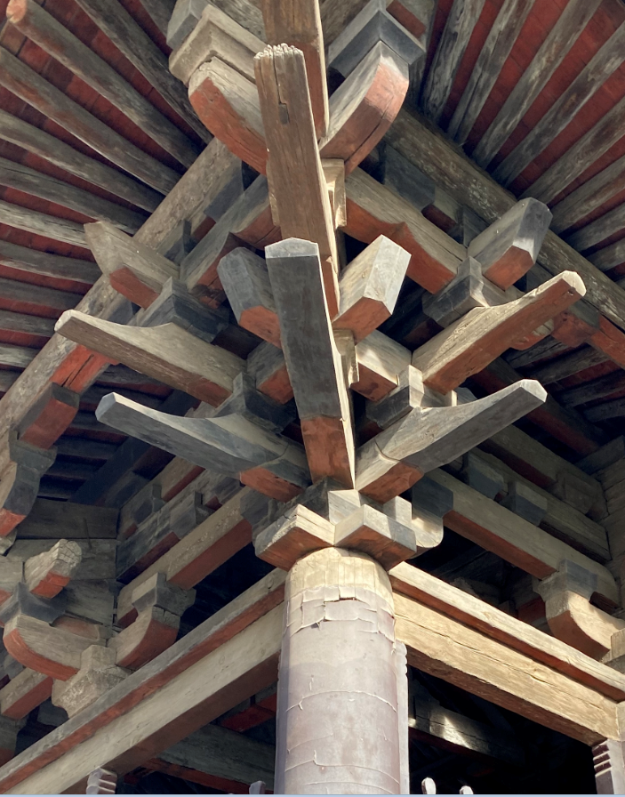
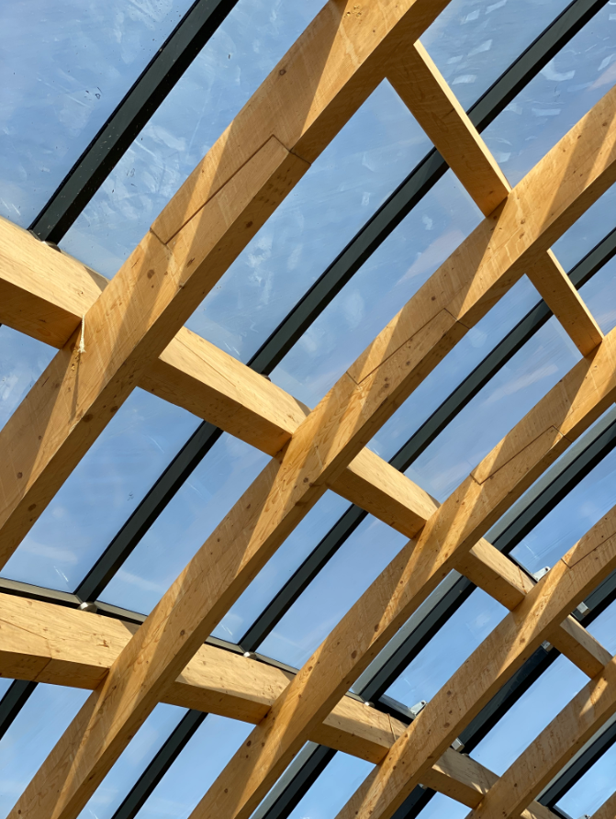
Introduction of Mass Timber Construction Code
in China and Lessons Learnt
Xu Fang
American Softwoods
Greater China and Southeast Asia
Notes:
··

Slide 2
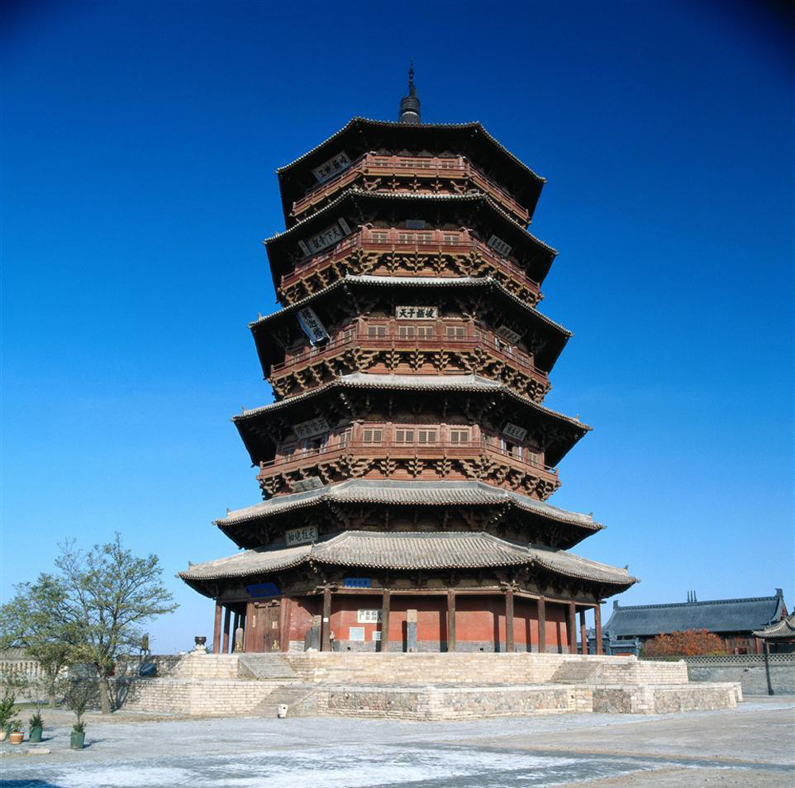
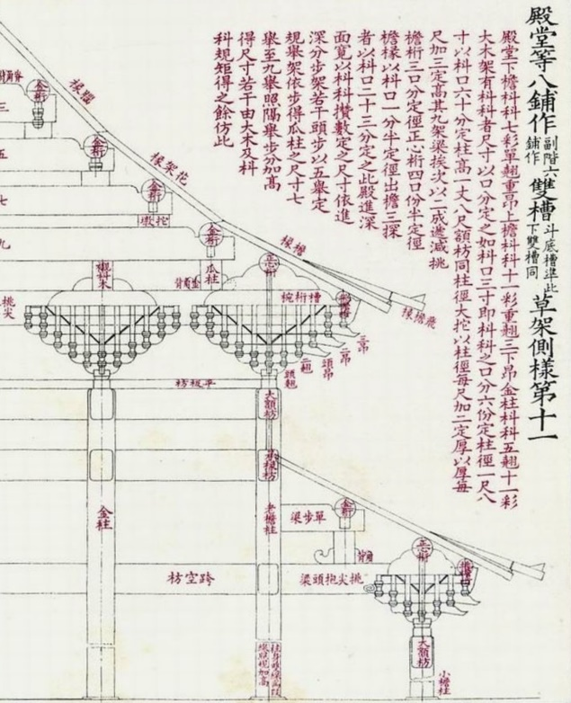
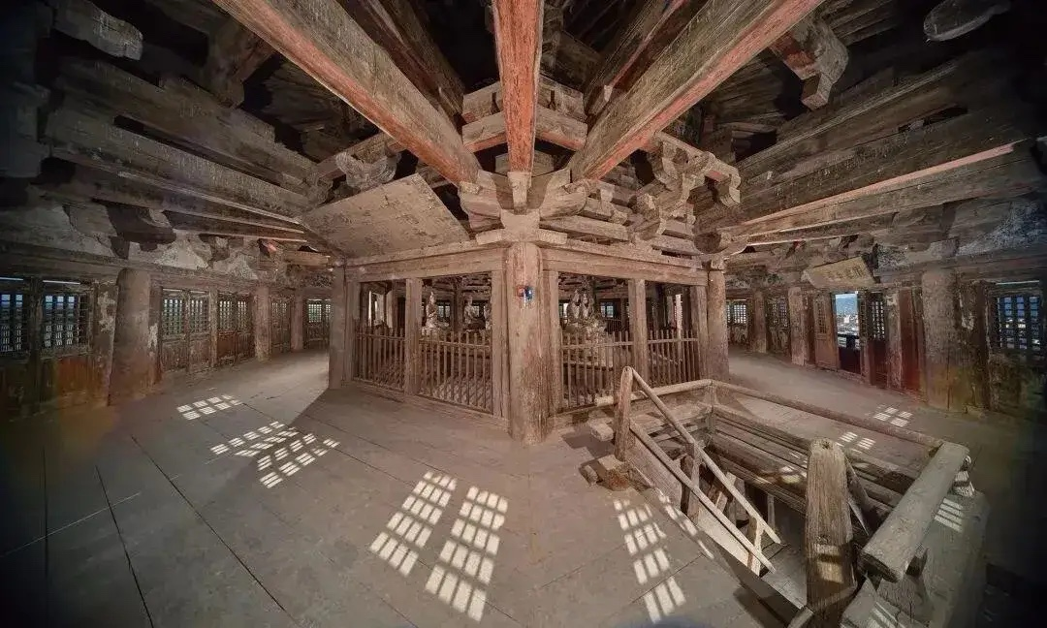
Yingxian Timber Pogoda
Built in 1056;
Height: 67.31 m
Ying Zao Fa Shi (Building Standards)
Developed in 1100;
Terms, measurements, design standards, construction principles, labor estimates, material data, recipes for decorative coating, etc.

Slide 3
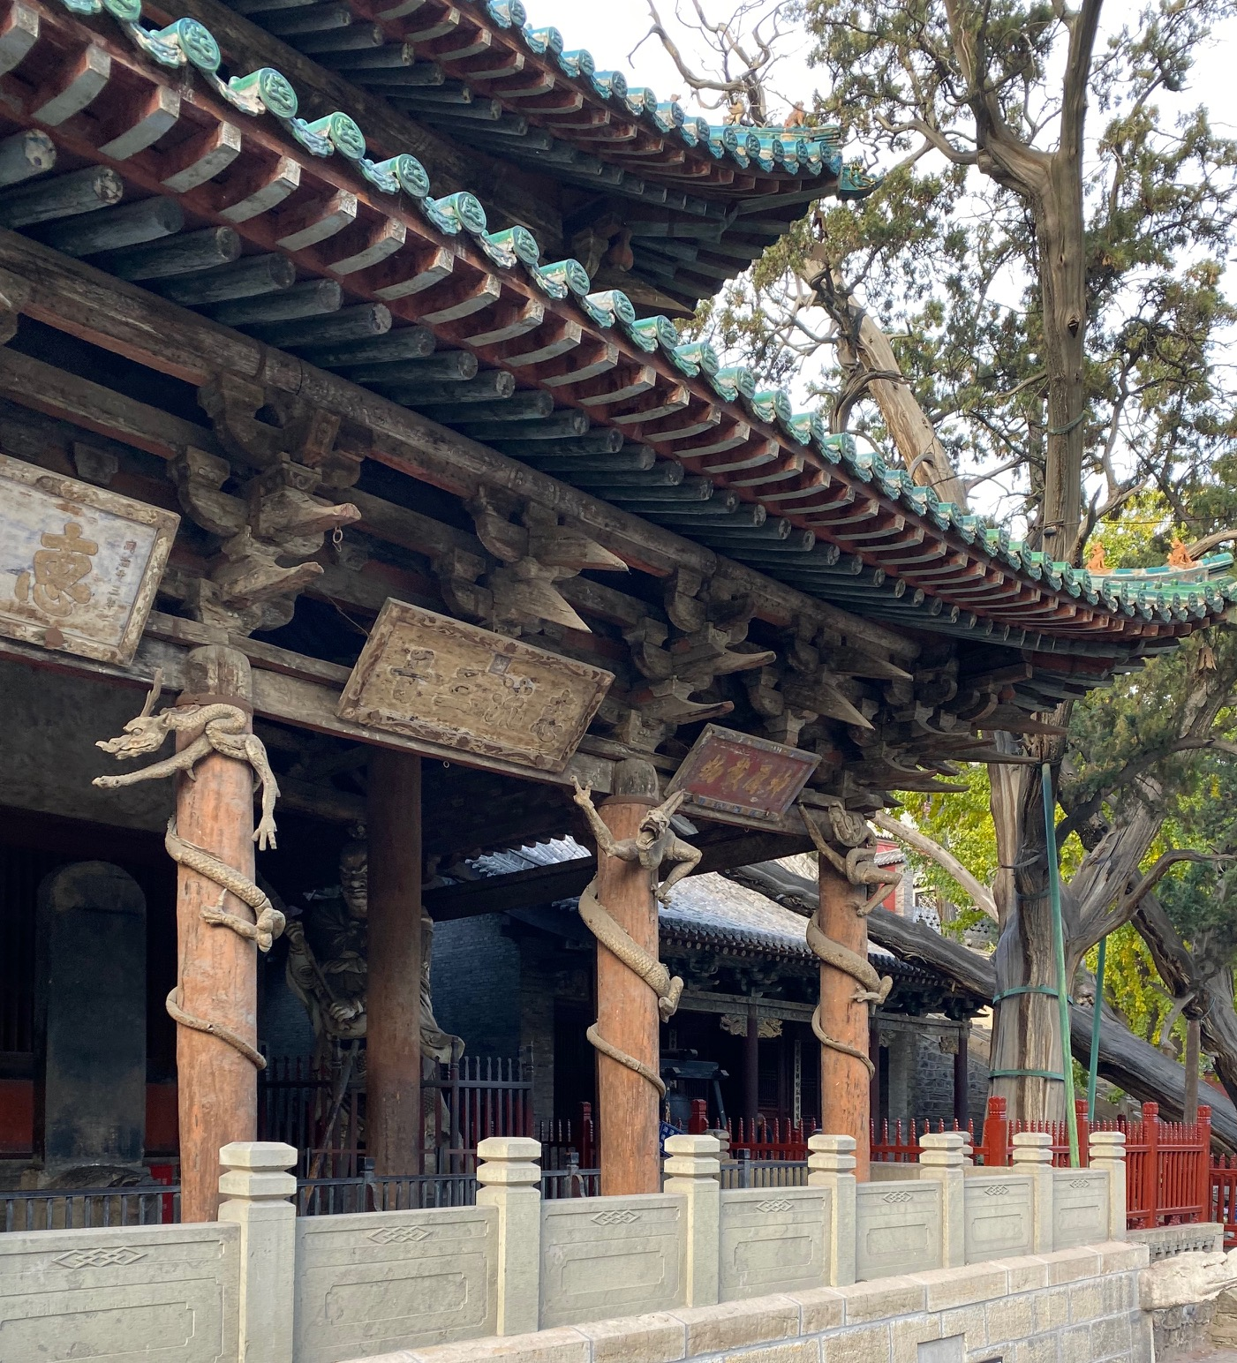
Temple in
Tang Dynasty (646 AD)

Slide 4
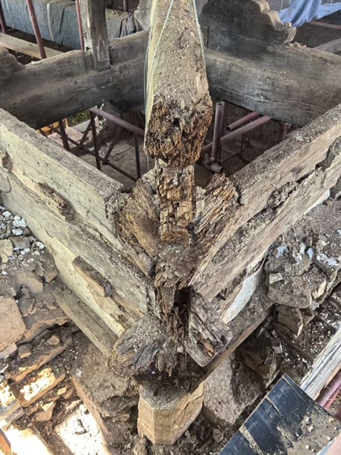
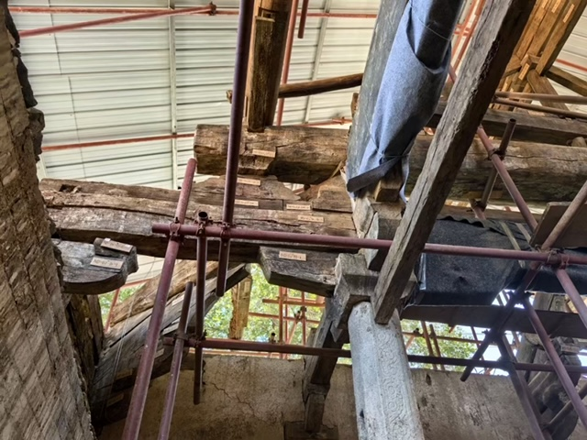
Yuanrong Temple, Shanxi

Slide 5
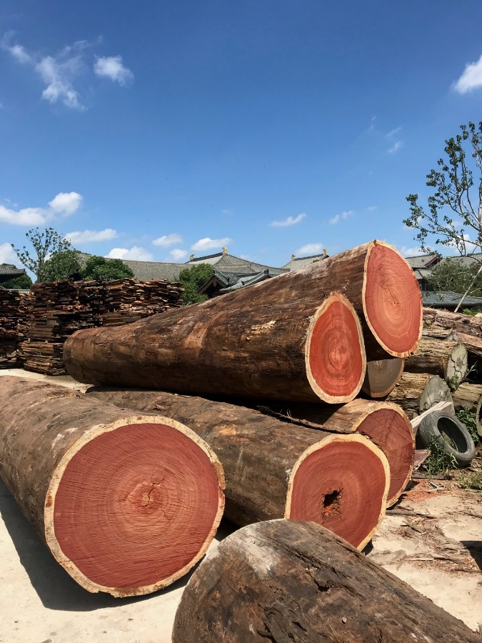
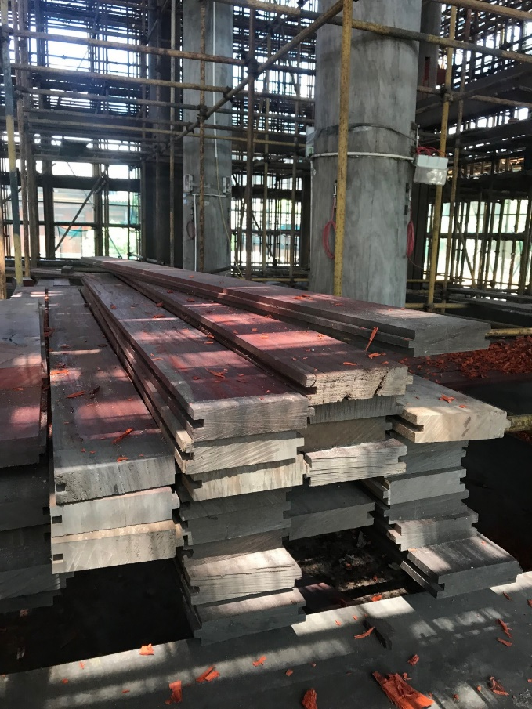
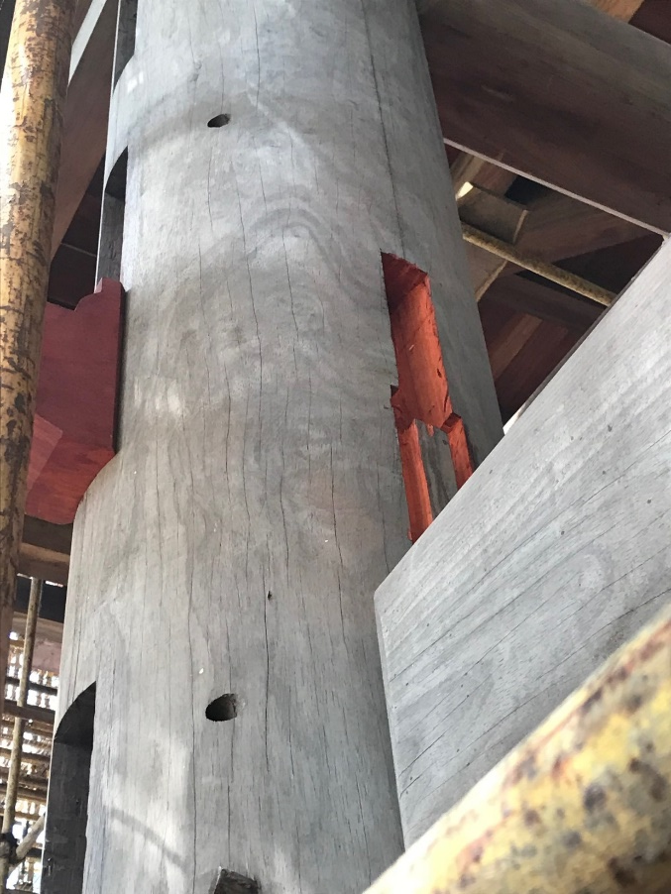
Baoshan Temple, Shanghai

Slide 6
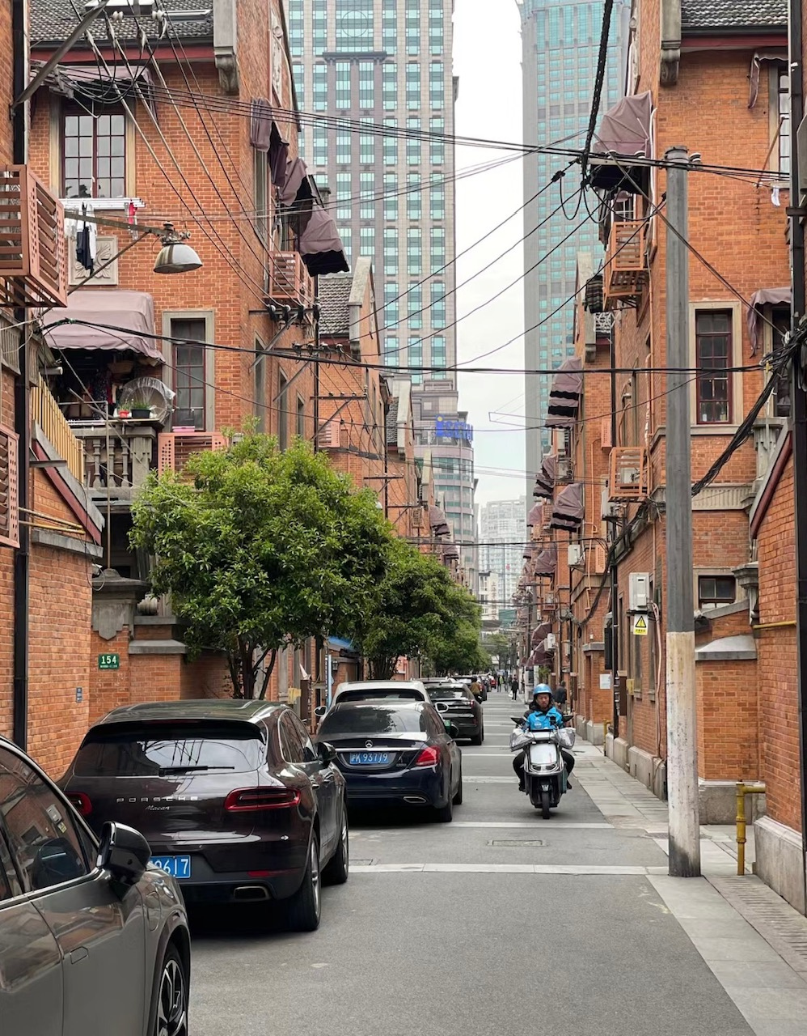
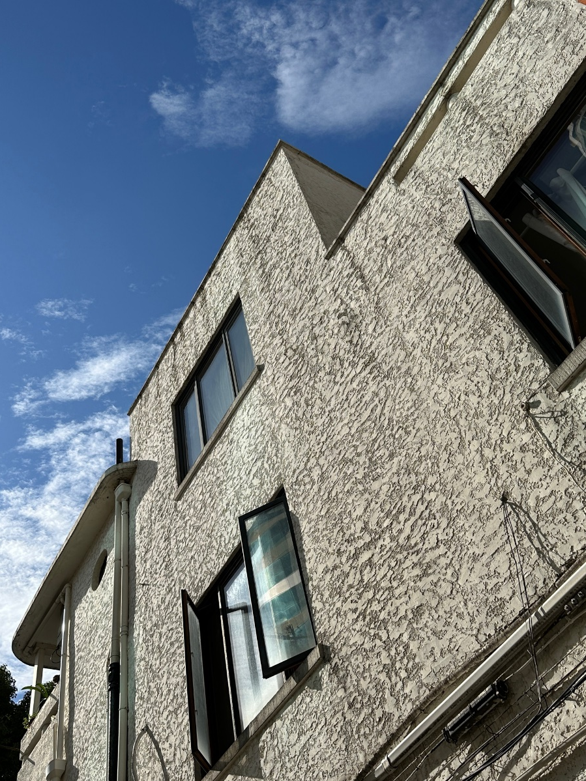
Residential Housing, Shanghai

Slide 7
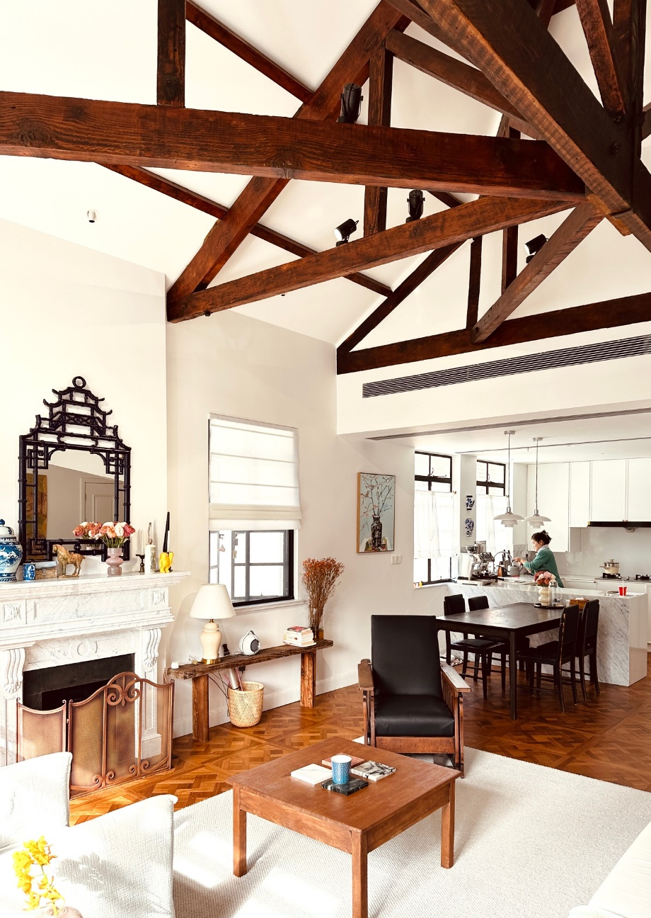
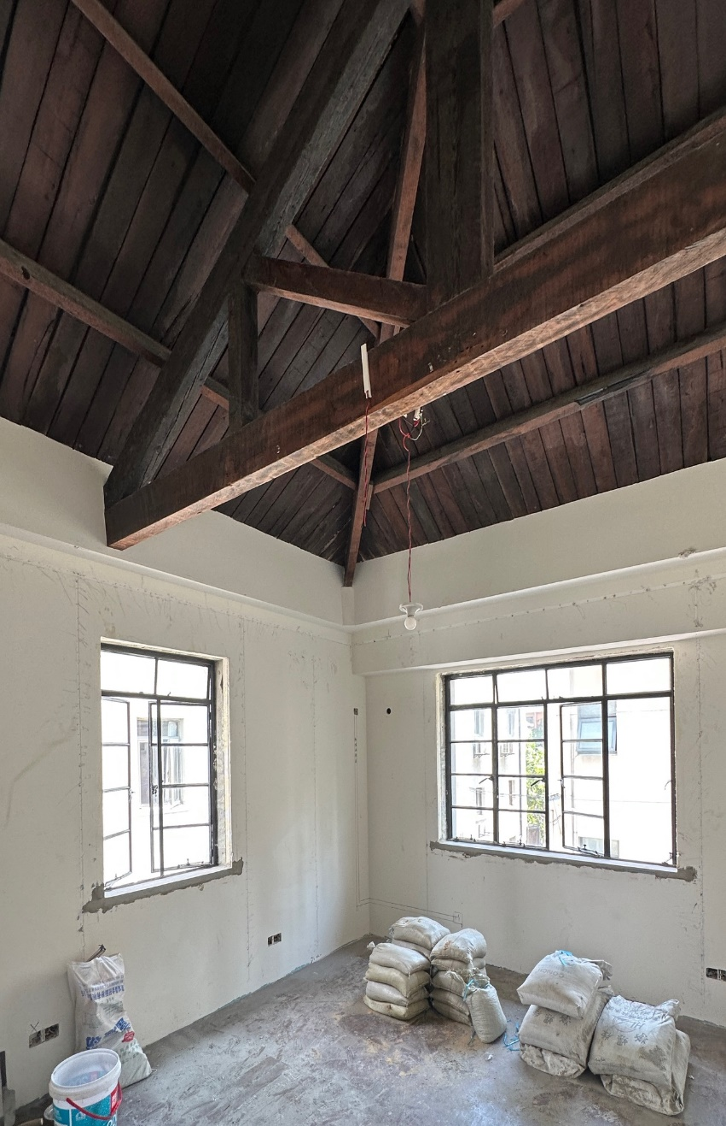
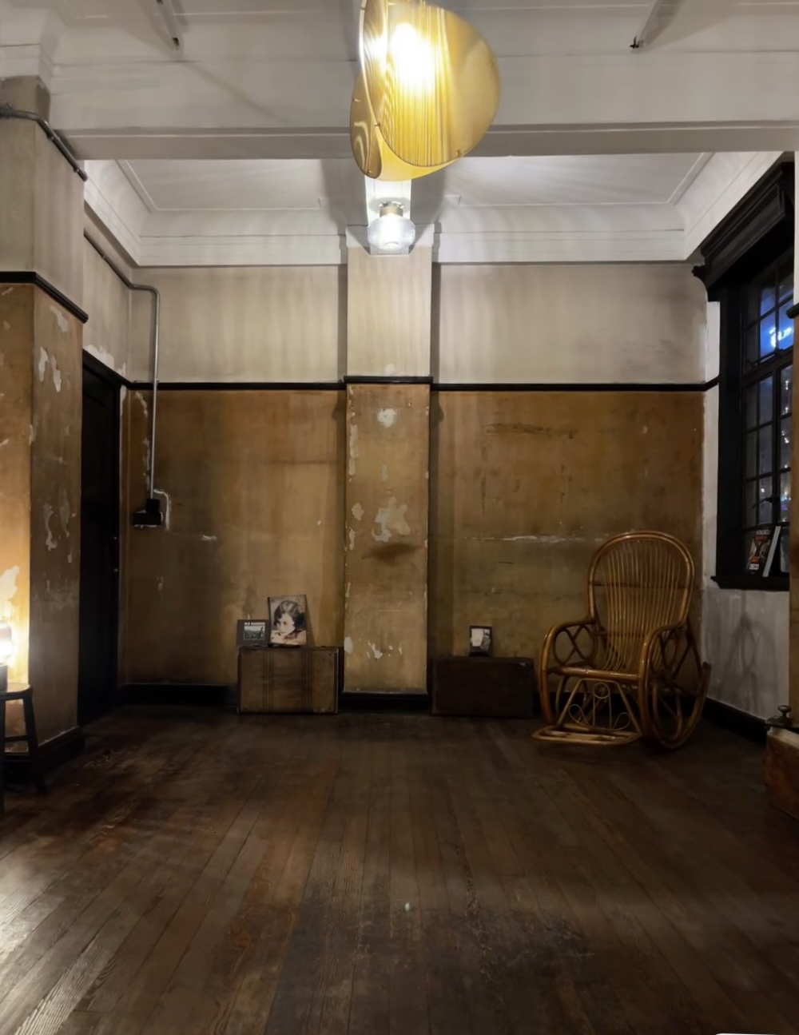
Residential Housing, Shanghai

Slide 8
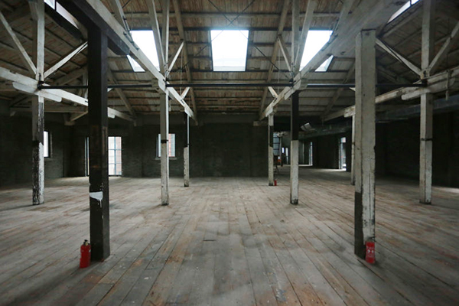
Industrial Applications, Shanghai

Slide 9
Development of Wood Construction
in China, 2000 - 2024
- Glulam construction
- Log houses (tourist)
- Outdoor structures
- WFC
- Post and beam
- Mass timber construction
- Glulam construction
- Log houses (tourist)
- Outdoor structures
- WFC
- Post and beam
- Outdoor structures
- WFC
- Post and beam
- Log houses (tourist)
- Outdoor structures
- WFC
- Post and beam
- Post and beam
2000
2005
2010
2015
2024

Slide 10
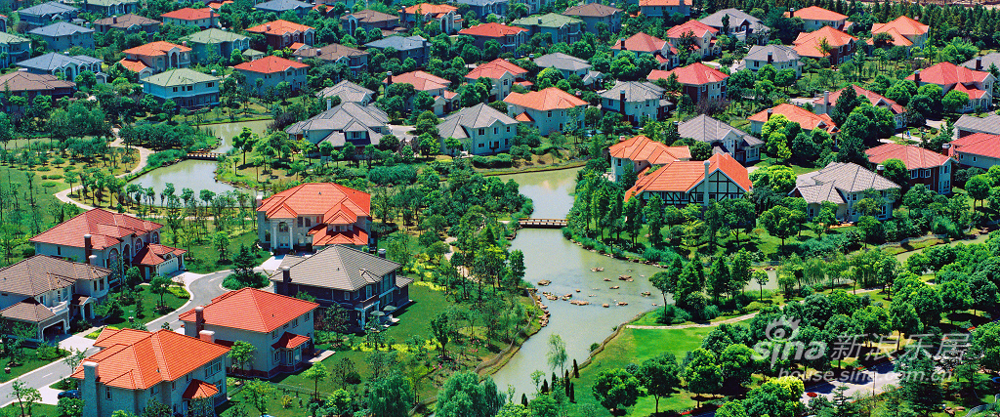
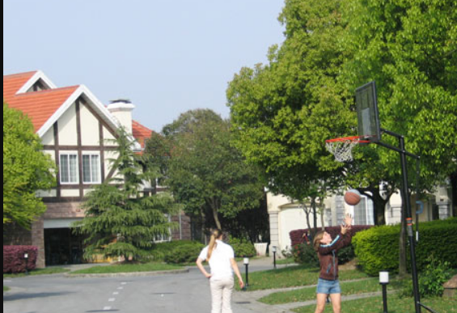
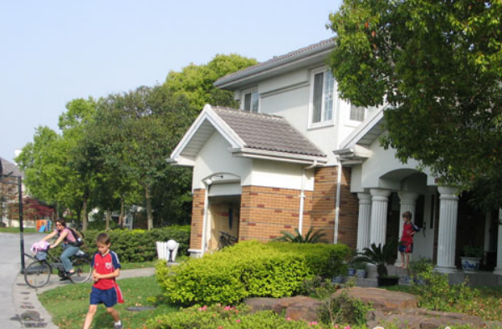

Slide 11
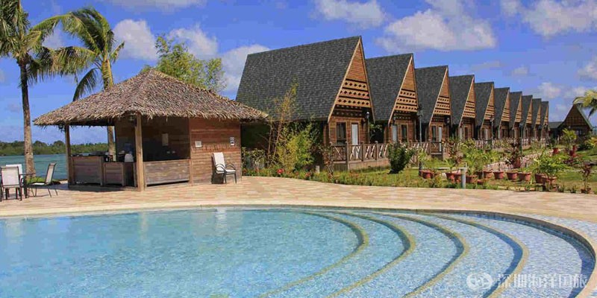
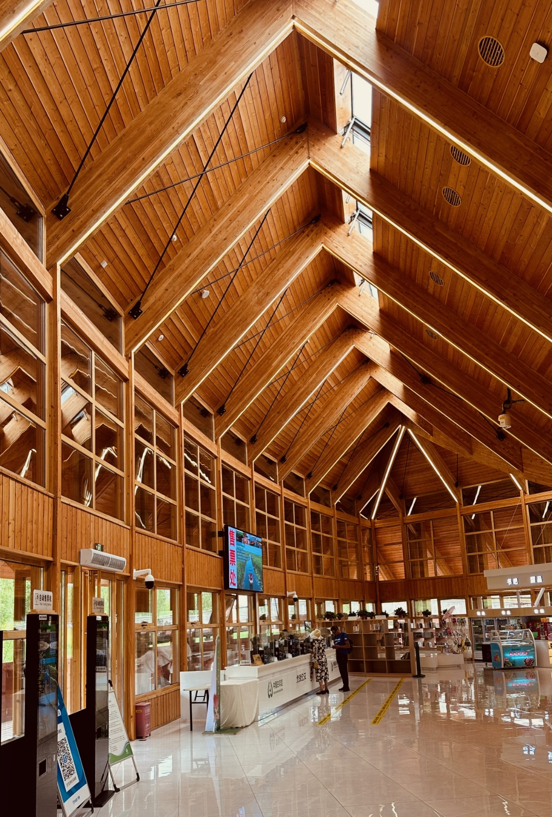
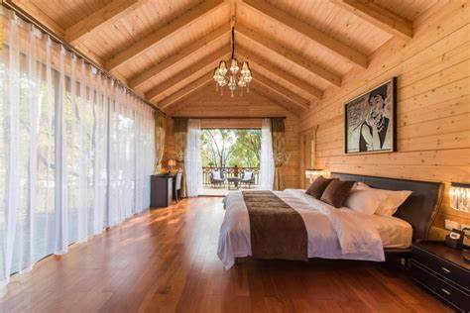

Slide 12
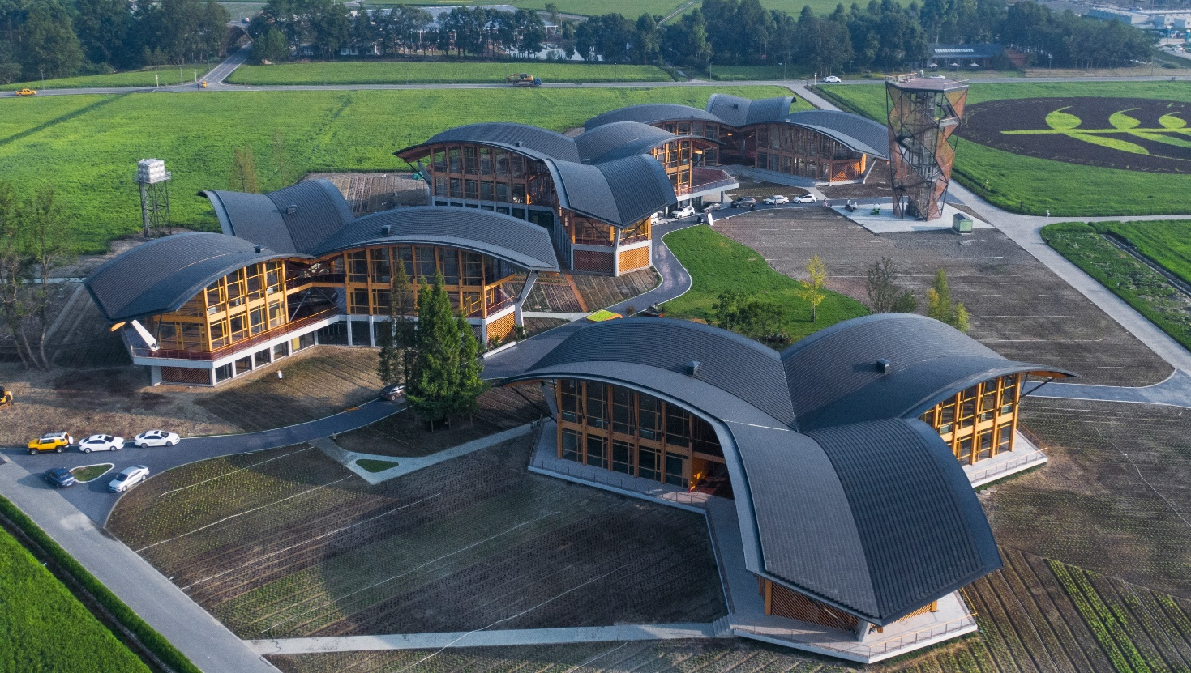
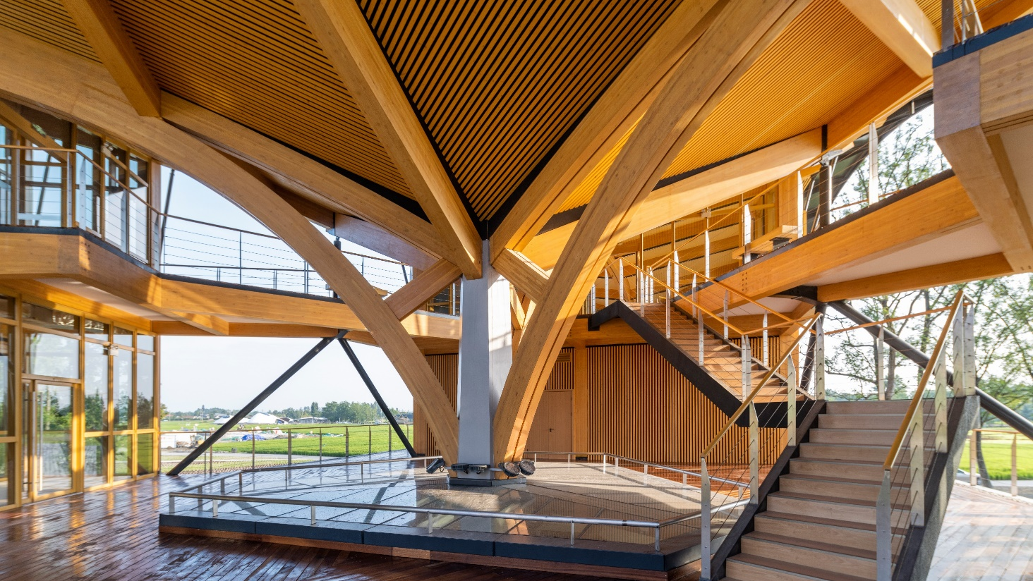
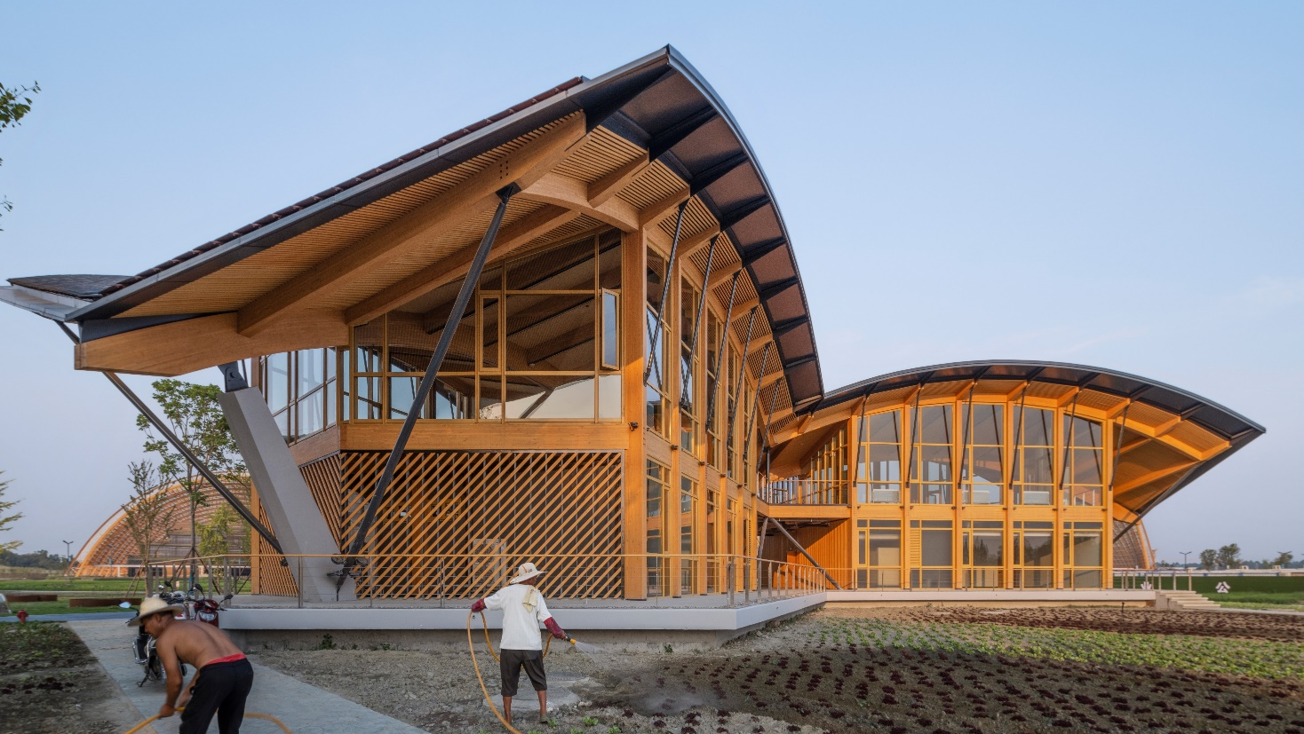
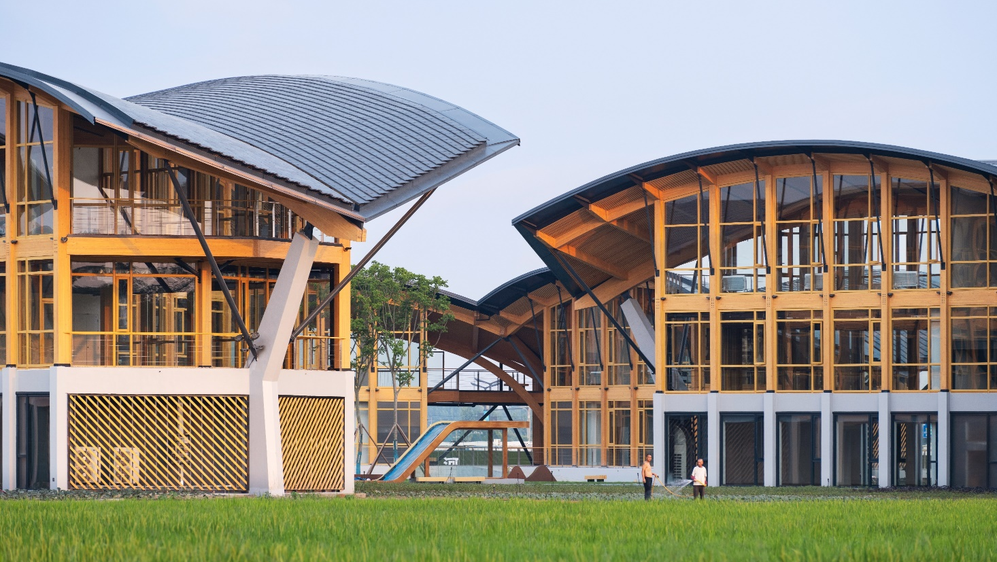

Slide 13
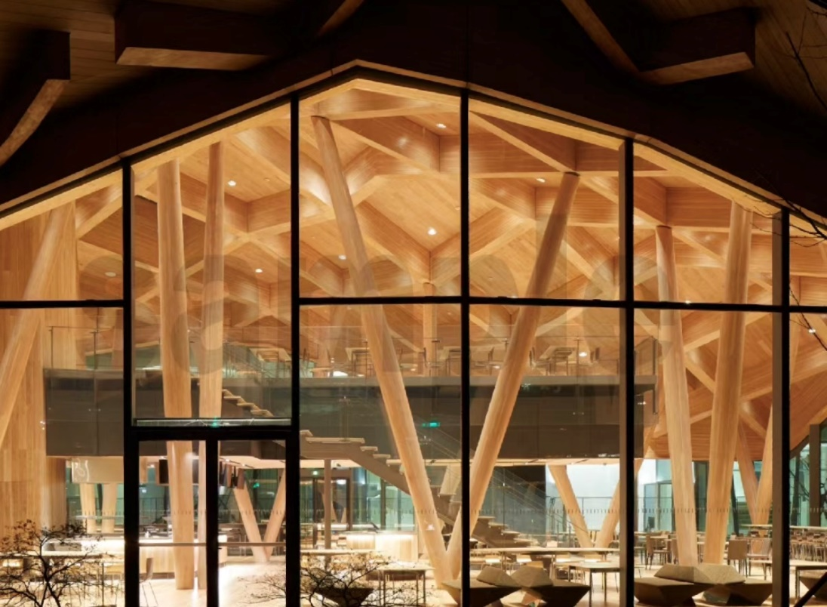
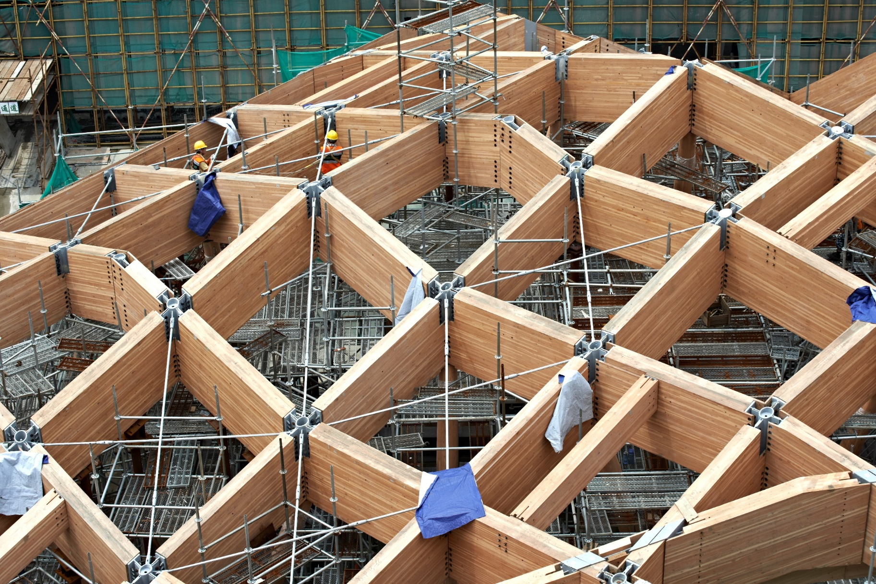
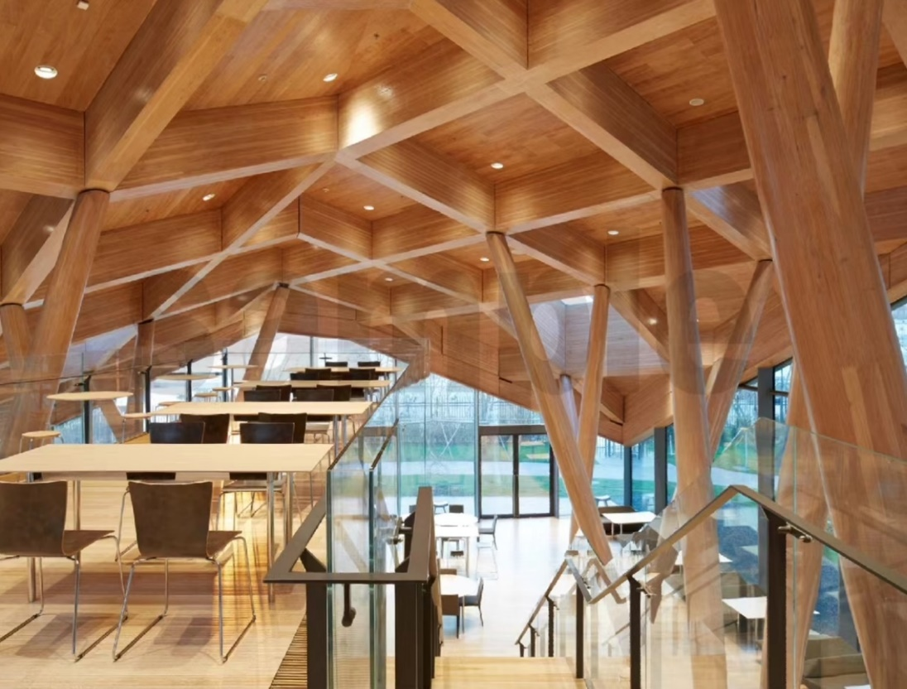
Novartis Shanghai Campus

Slide 14
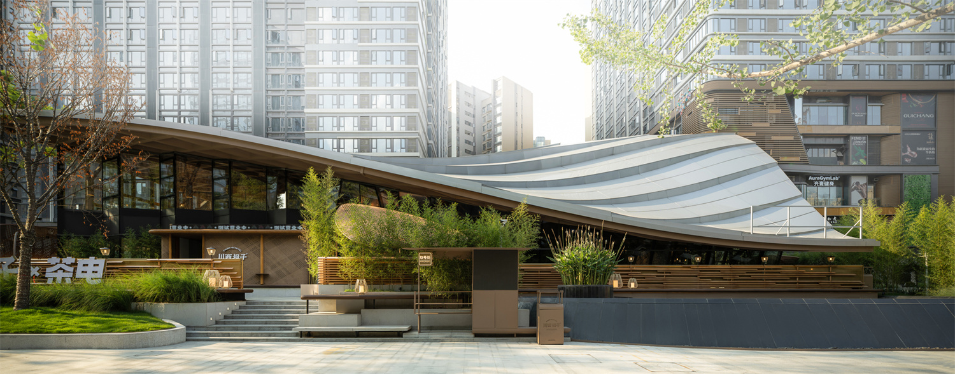
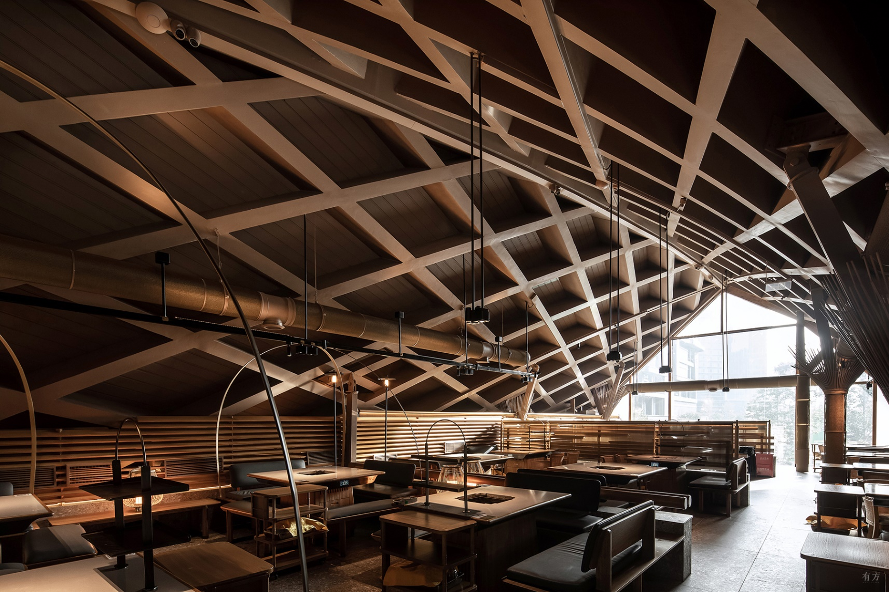
Hotpot Restaurant, Chengdu

Slide 15
Hotpot Restaurant, Chengdu

Slide 16
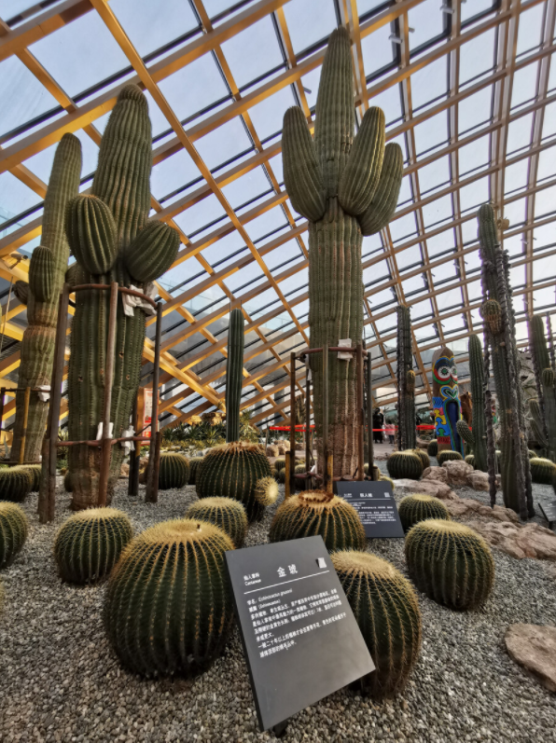
Botanic Garden, Shanxi

Slide 17
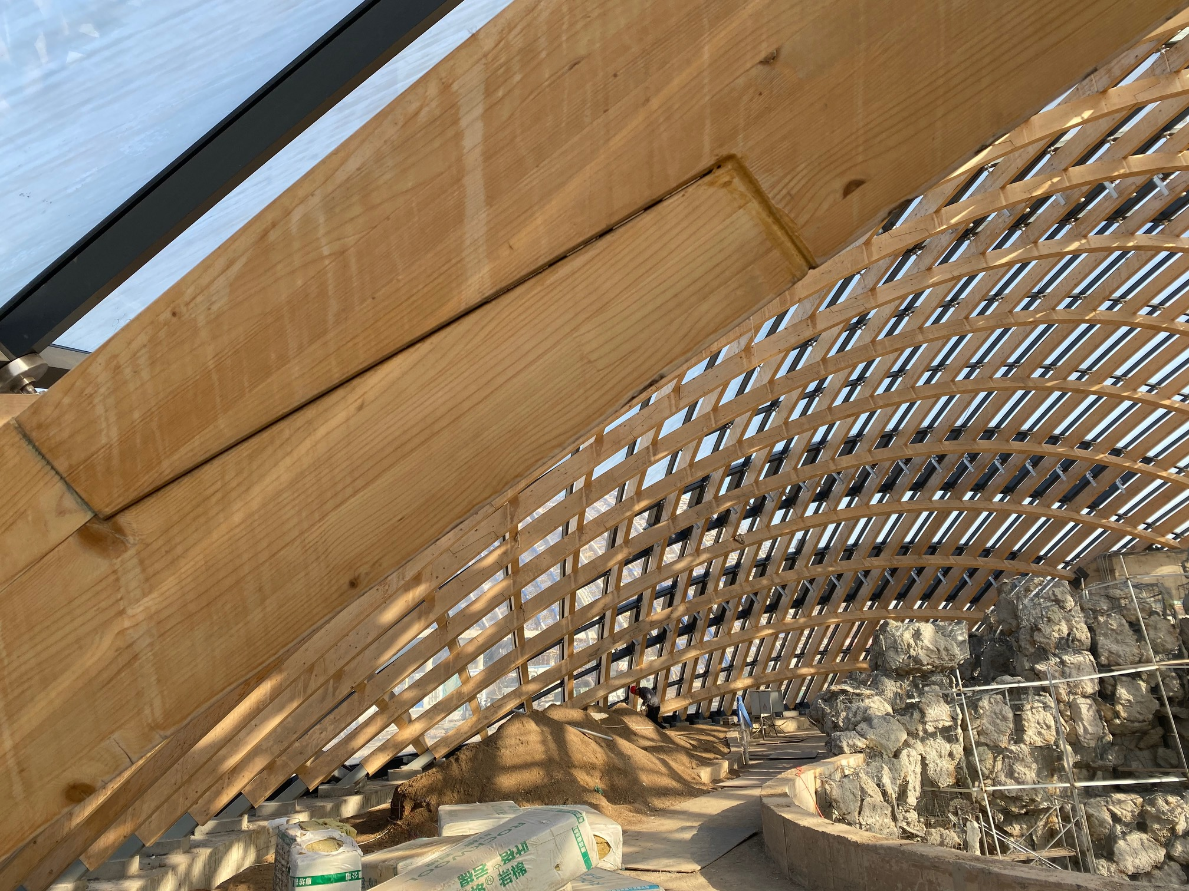
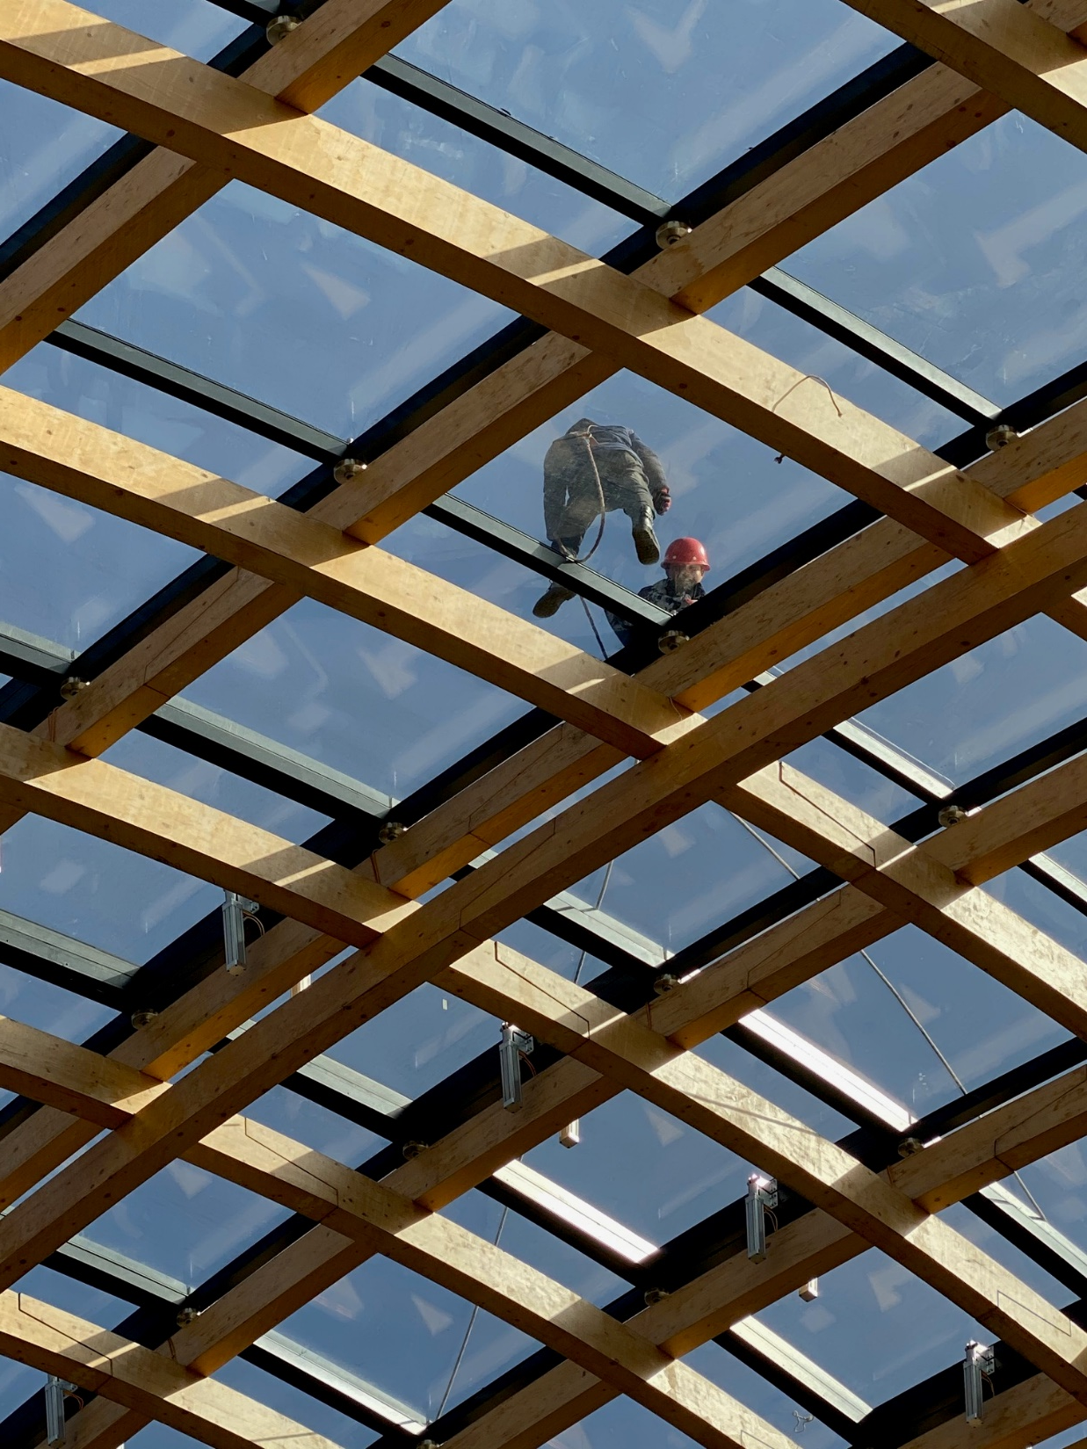
Botanic Garden, Shanxi

Slide 18
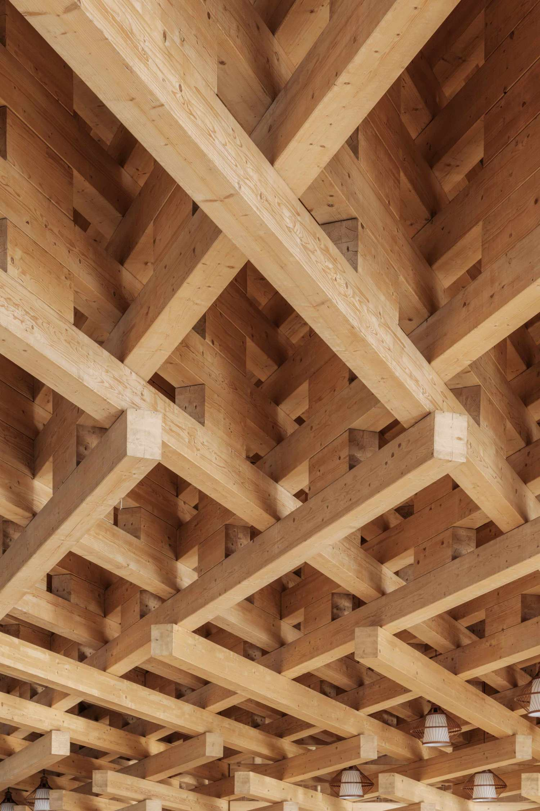
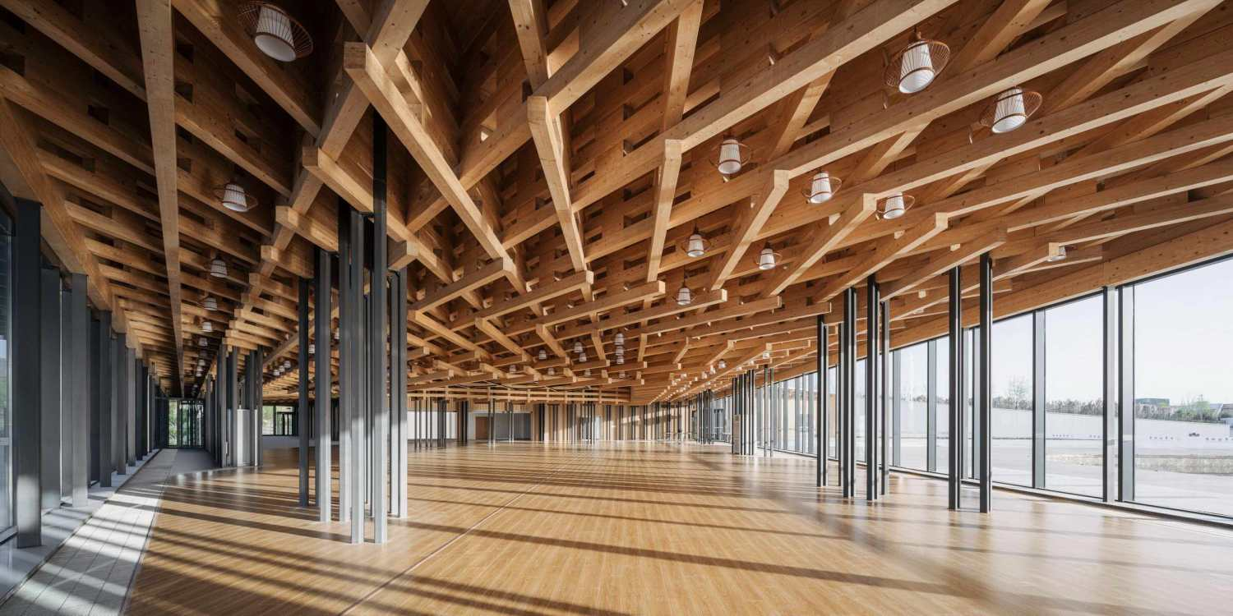
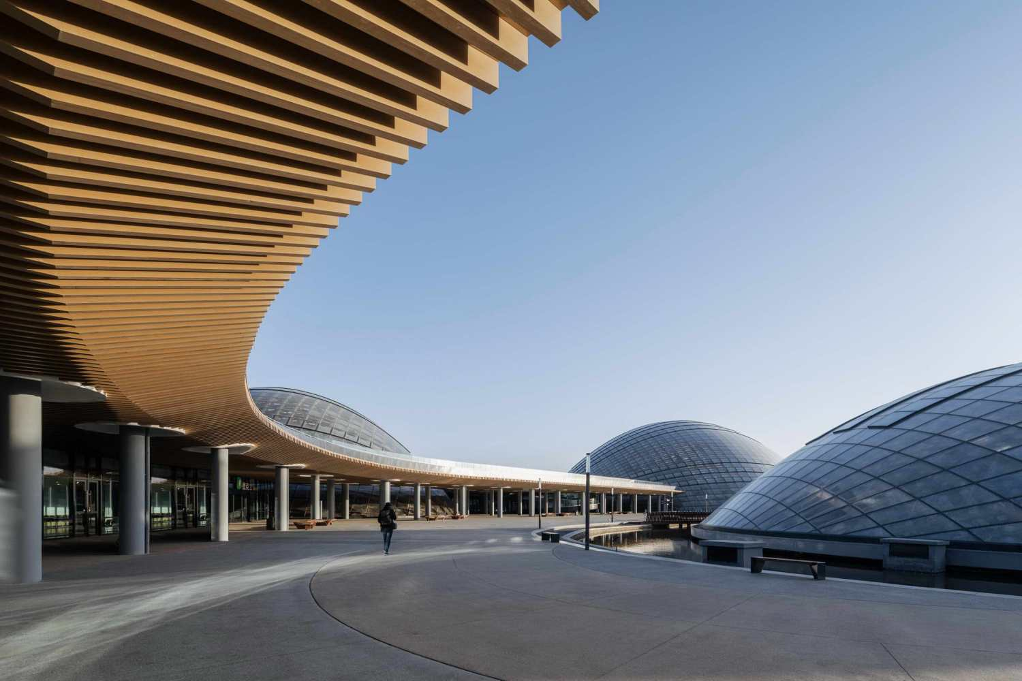
-
Botanic Garden, Shanxi

Slide 19
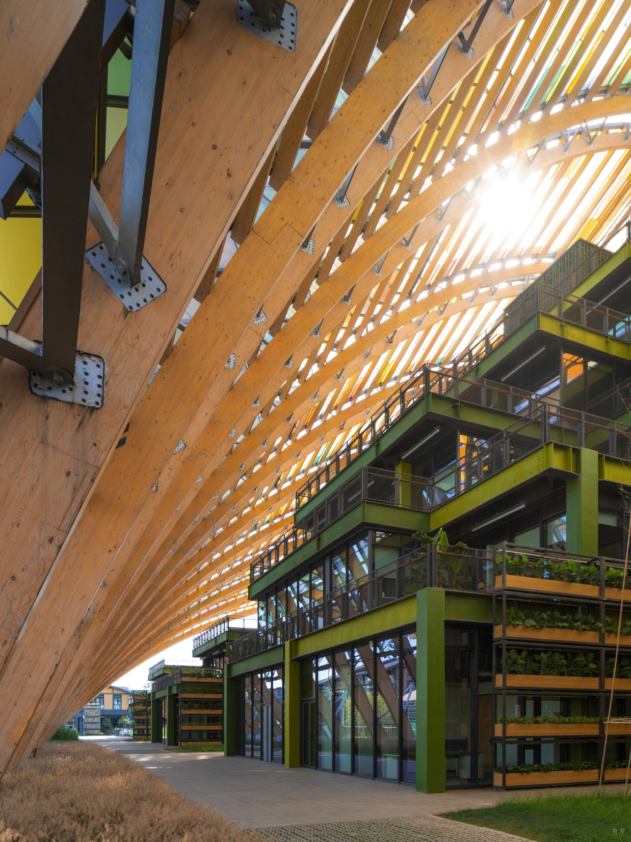
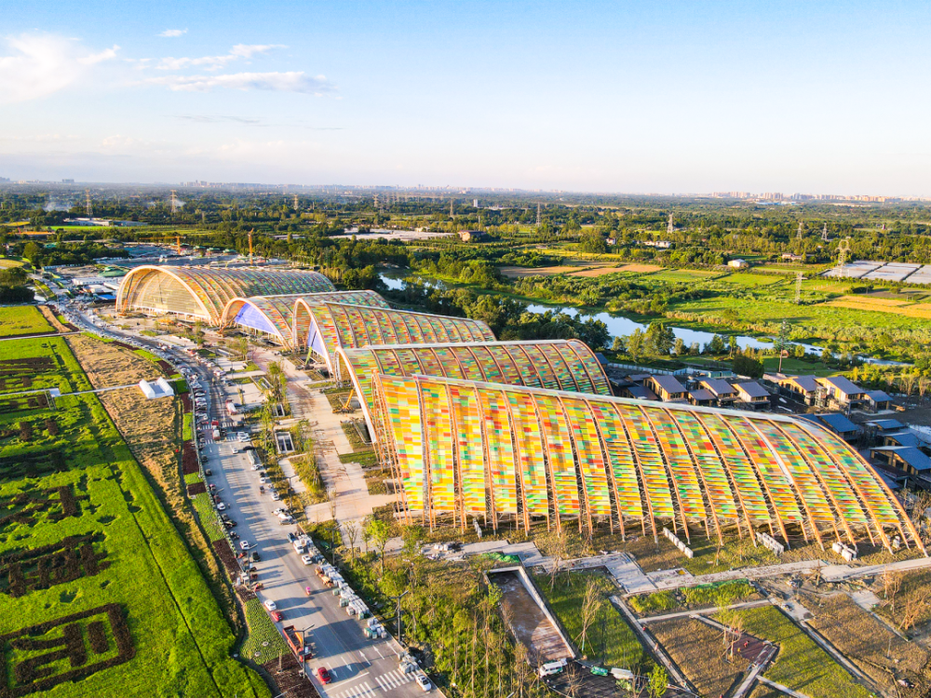
Agpark, Chengdu

Slide 20
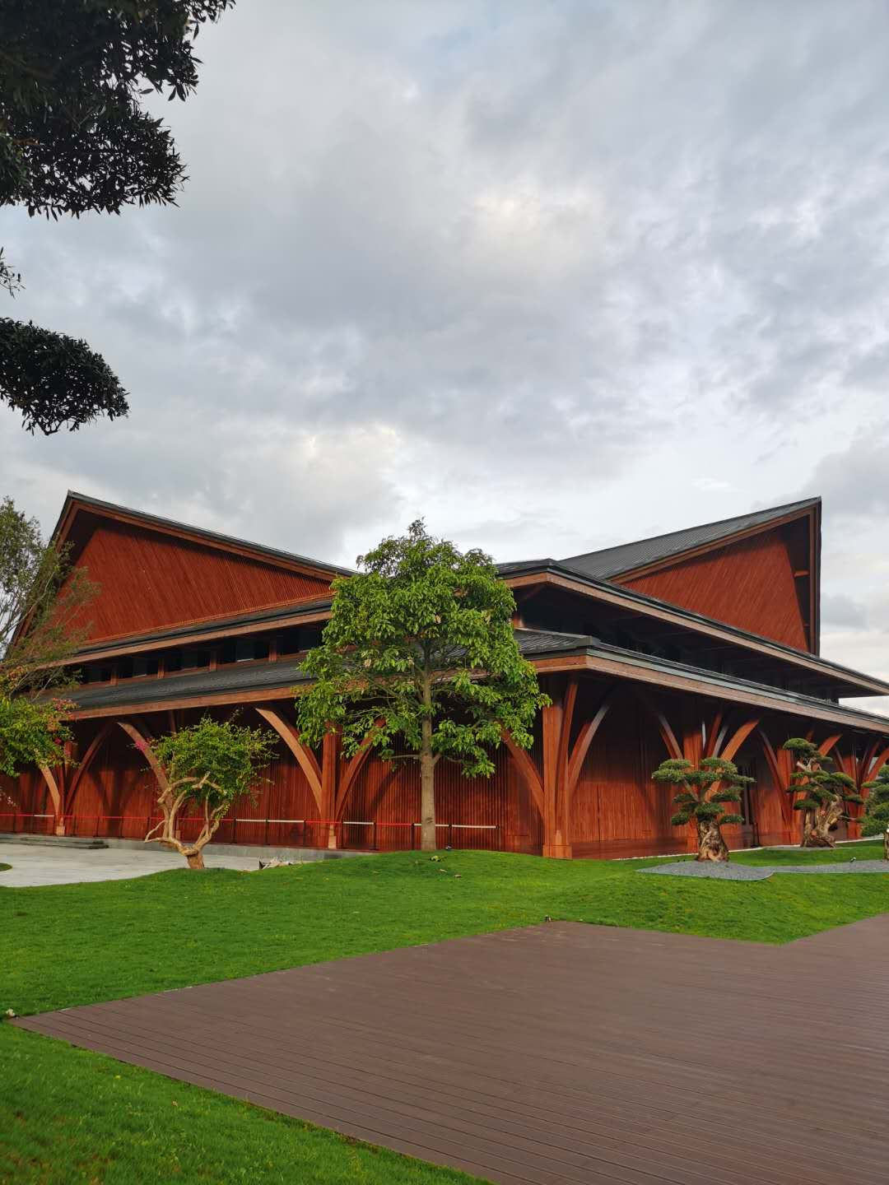
Convention Center, Yunnan

Slide 21
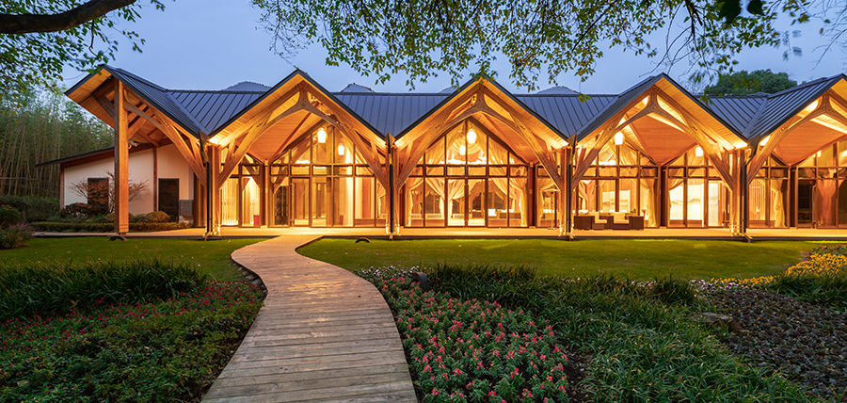
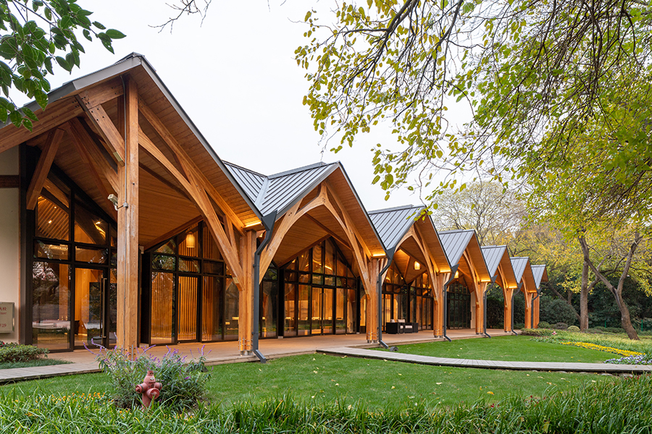
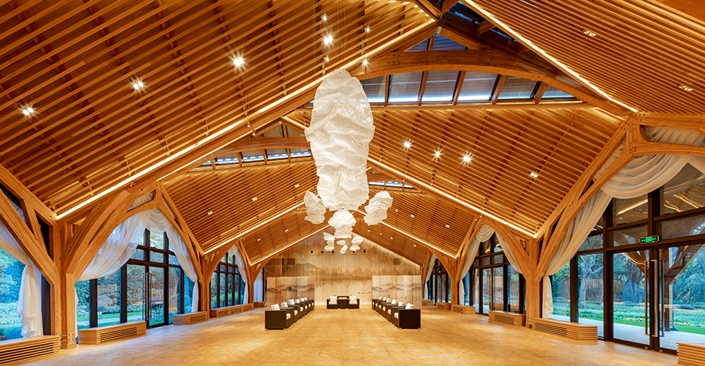
Convention Center
Shanghai

Slide 22
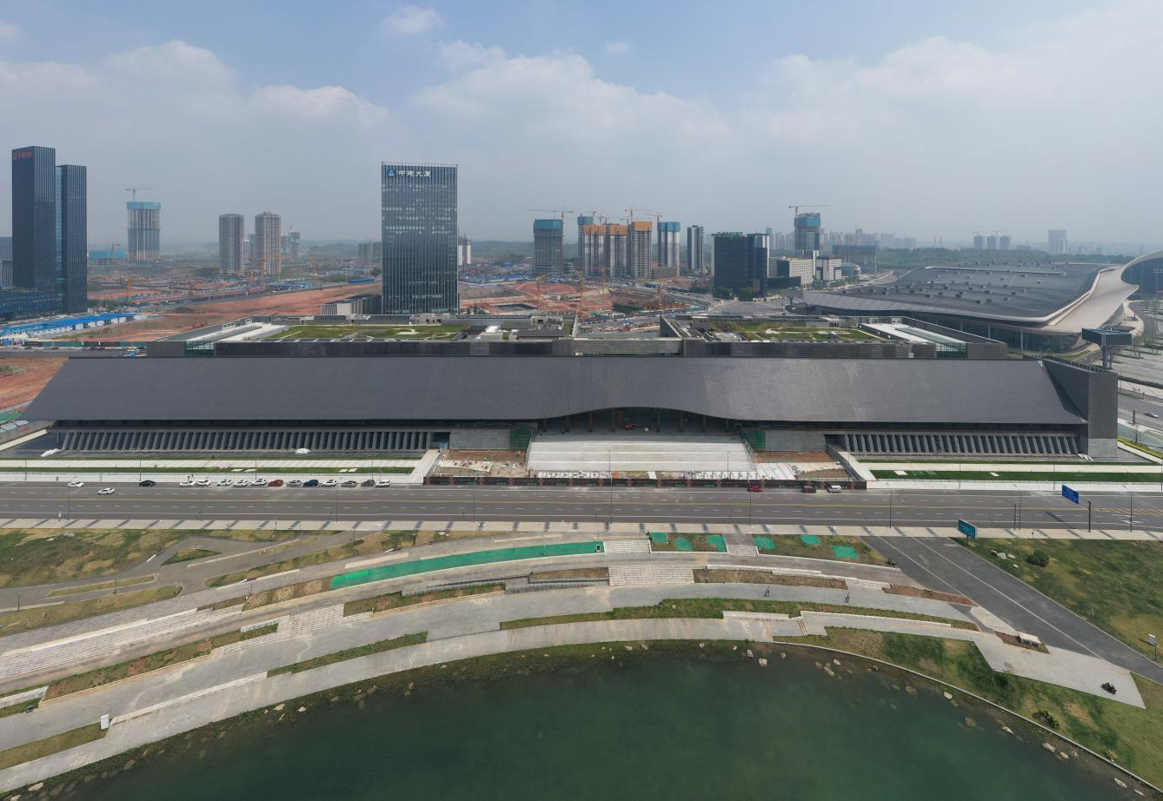
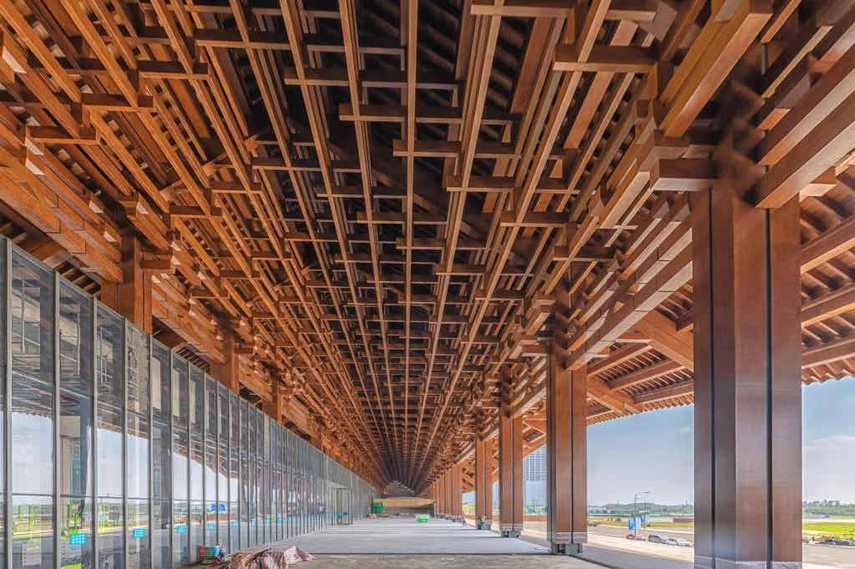
Convention Center, Chengdu
Convention Center, Sichuan

Slide 23
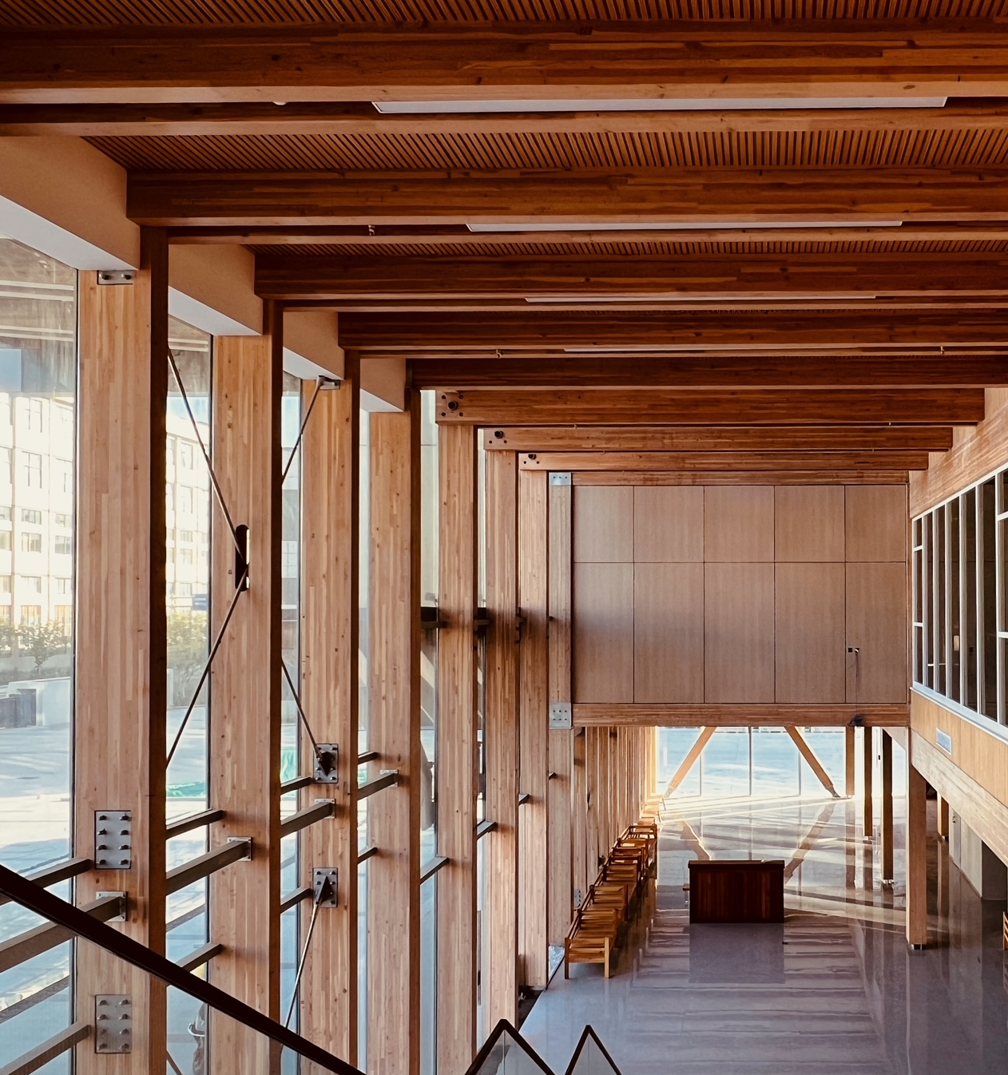
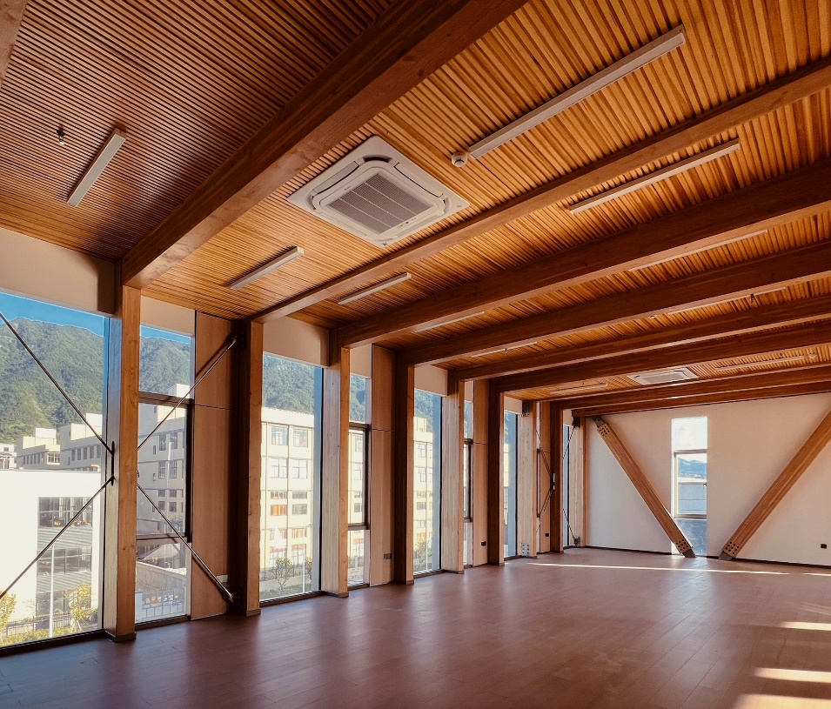
Office building, Zhejiang

Slide 24
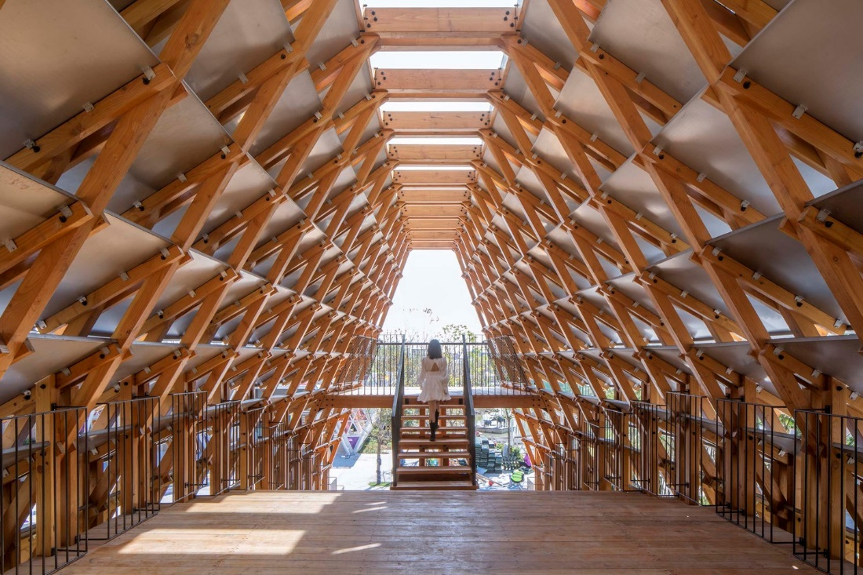
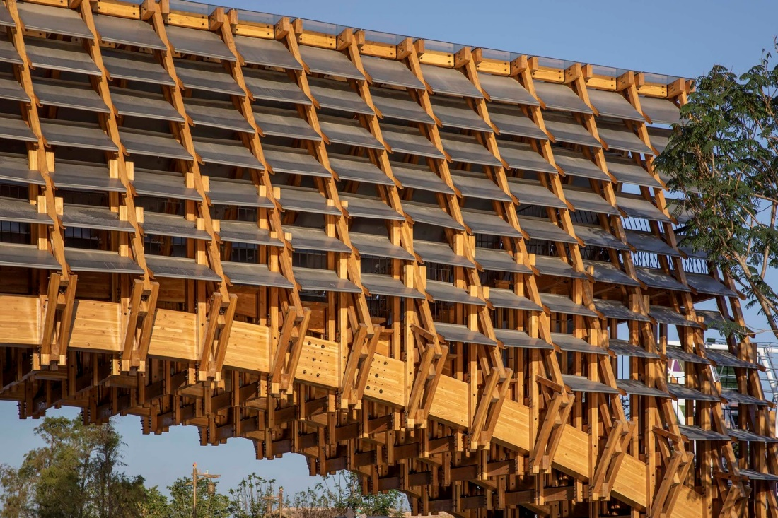
Gulao Bridge, Jiangmen, Guangdong

Slide 25
Covered Bridge, Huangshan
Anhui Province

Slide 26
Overpass, Gansu
Notes:
.

Slide 27
Overpass, Changsha, Hunan Province

Slide 28
5 CLT
Manufacturers
Currently in China
Dalian, Liaoning
Qianan, Hebei
Binzhou, Shandong
Yancheng, Jiangsu
Ningbo, Zhejiang
Two more lines are under construction

Slide 29
Office Building, Shandong
Notes:
.

Slide 30
China Standardization System
5 levels – National Standards, Sector Standards, Local Standards, Association Standards, and Enterprises Standards
Market-driven
Association standards
Consortia standards
Government-led
Mandatory national standards
Recommended (voluntary) national standards
Sector Standards
Local standards
Enterprise standards
Not in the official system but de facto exist
Adoption of international standards (ISO/IEC, ITU) are limited within national standards and sector standards if necessary.
Other International/Global Standards including IEEE, W3C, 3GPP, etc.,
International Consortia Standards including 3GPP
International Consortia Standards
Functioned as technical regulation;

Slide 31
China currently has around 110 codes and standards relating with wood construction
National mandatory standards – mandatory
National recommended standards – voluntary
Sector standards – voluntary

Slide 32
Development of Codes and Standards for Wood Construction, 2000 - 2024
- Fire design open to HT and MTC
- Multi-story and high-rise buildings
- Glulam construction
- Wood frame construction
- Post and beam
- Fire design open to WFC
- Wood frame construction
- Post and beam
- Fire design open to glulam con.
- Glulam construction
- Wood frame construction
- Post and beam
- Post and beam
2000
2010
2015
2024

Slide 33
SEC has involved in the development of following standards
1 | Timber Structure Design Standards （GB 50005） | National standard
2 | Design standard for Glulam Structure (GB/T 50708) | National standard
3 | Technical Standards for Multi-story and high-rise buildings (GB/T 51226) | National standard
4 | Standard for Prefabricated Wood Construction (GB/T 51233) | National standard
5 | General Code for Timber Structure (GB 55005) | National standard
6 | Standard for Inspection of Timber Construction (GB 50206) | National standard
7 | Standard for Construction of Timber Structure (GB/T 50772 | National standard
8 | Standard for Wood Construction Testing Methods (GB 50329) | National standard
9 | Structural Glued Laminated Timber (GB/T 26899) | National standard

Slide 34
Most recent development
Technical Standards for multi-story and high-rise buildings
Cross Laminated Timber

Slide 35
Allowable Building Heights and Number of Stories
Wood Construction
Hybrid Construction
HT & MTC
WFC
Post & Beam
HT & MTC
WFC
Post & Beam
≤ 32m (8)
≤ 15m (4)
≤ 10m (2)
≤ 36m (9)
≤ 24m (7)
≤ 15m (3)

Slide 36
American Softwoods is a promotional partnership formed by three major US softwood trade associations: the Southern Forest Products Association, the Softwood Export Council and the APA, the Engineered Wood Association.

Slide 37
Thank You
Xu_fang@amso-china.org

